Slide 1
Human Perspectives A Brief Proof Of Human Blindness
What You See Is Not What You Interpret

Slide 2
Faulty Vision Or Faulty Brains? A Brief Proof Of Human Blindness
The easiest way to demonstrate our “faulty” nature is through some visuals – and our people are experts in demonstrating this – visually and with practical examples that most of us humans are….a bit faulty.
Remember, it is very difficult to convince a human of the righteousness of some action (or report) if his living and reputation depends on not accepting it.
Breaking away from this mold is exactly what needs to happen – by the majority of those participating in data intelligence projects – if we want to succeed.

Slide 3
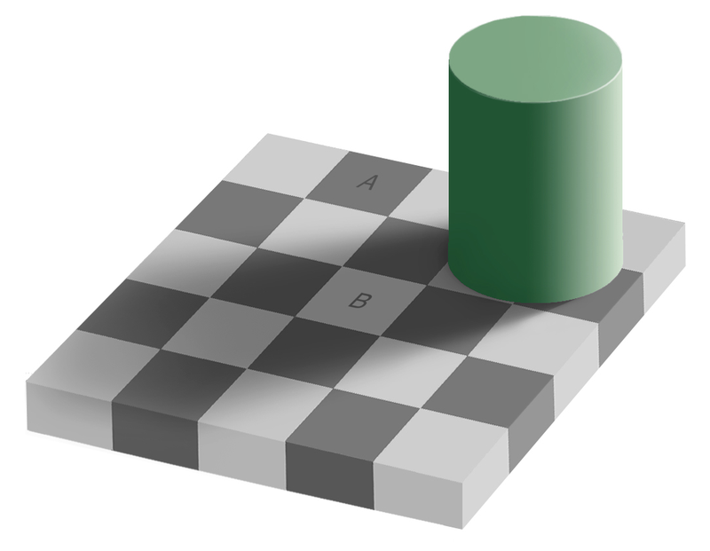
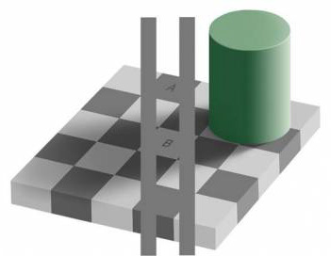
Do We Really See The Truth? Or Is The Truth Elusive & We Make It Up As We Go?
Take a look at the left image – are the marked blocks (A and B) a different color?
Take a look at the right image – it helps prove two seemingly different colors are the same.
Knowing “THE TRUTH”, look at the right image and try to see the colors that you now KNOW are the same. ARE THEY?

Slide 4
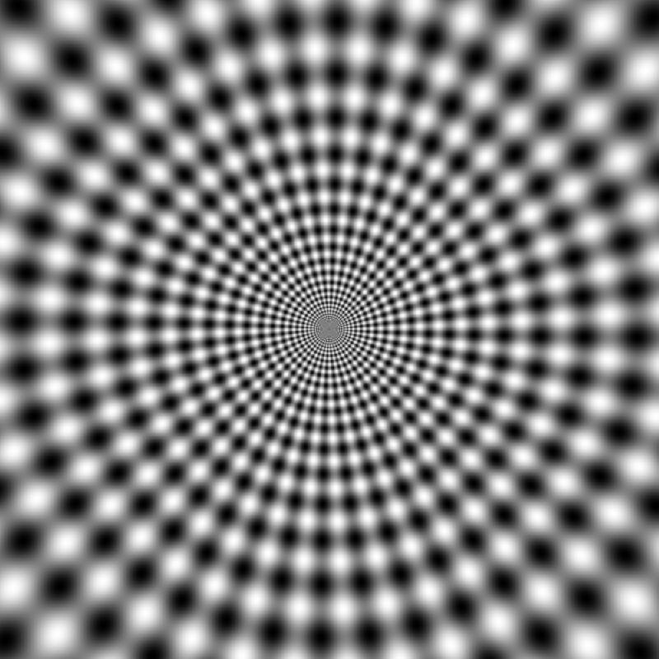
Do We Really See The Truth? Or Is The Truth Elusive & We Make It Up As We Go?
Is this stationary picture moving?
HINT : It’s not moving – but you can still see flicker in it.
Are we moving forward with our business in a real way or do we just have an illusion of moving while we are actually remaining standing still?

Slide 5
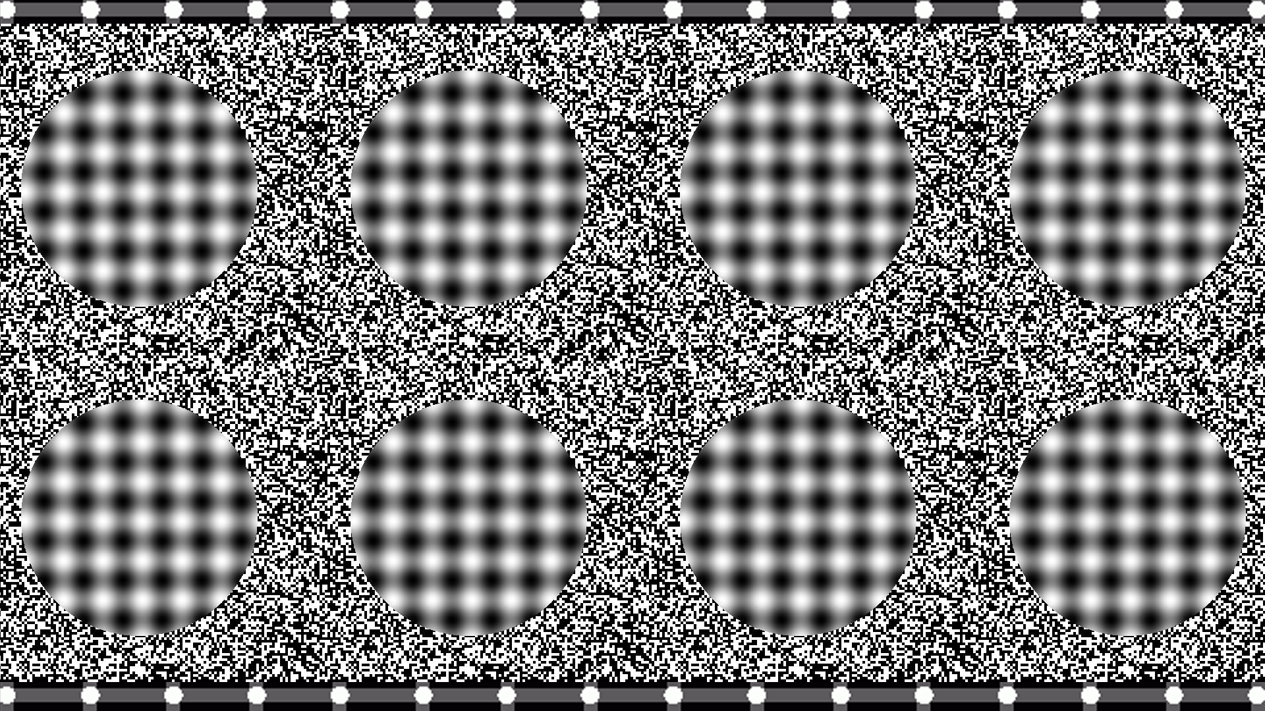
Do We Really See The Truth? Or Is The Truth Elusive & We Make It Up As We Go?
Are the circled areas of this stationary picture moving or showing depth?
HINT : They are not moving – but you can still see motion in them and your brain sees depth.
Are we seeing depth and complication in our business where all there really is out there is the perception of depth but not really much else?

Slide 6
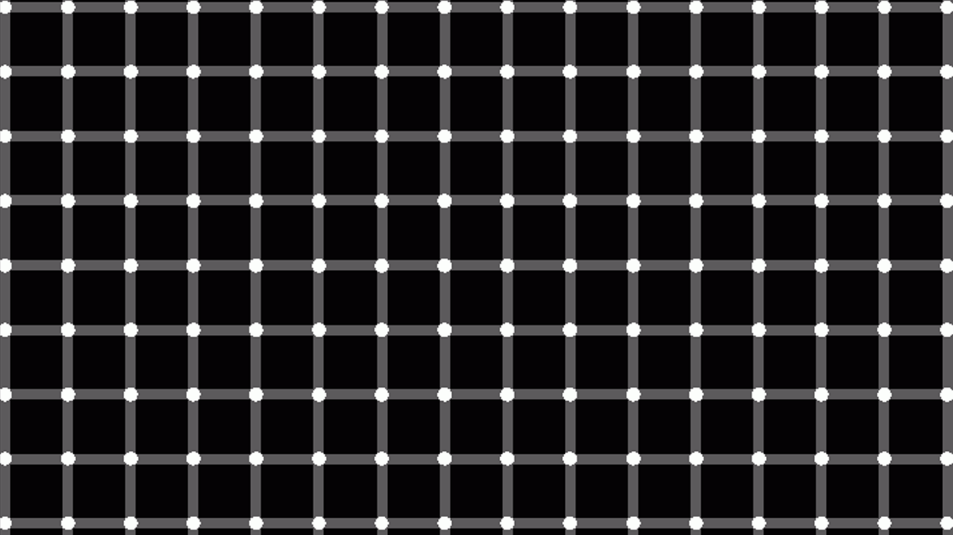
Do We Really See The Truth? Or Is The Truth Elusive & We Make It Up As We Go?
Take a look at the white dots – can you count them? Do they seem elusive?
HINT : The white dots are always there – it’s our brain that has a hard time seeing them all lit up.
Are we interpreting data or counting performance in our business in the same manner?

Slide 7
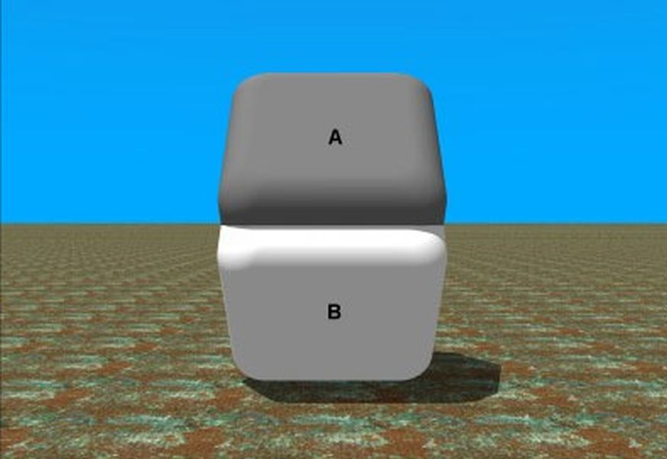
Do We Really See The Truth? Or Is The Truth Elusive & We Make It Up As We Go?
Our perceptions are simply a matter of context.
In this example, the background frames the context in line with our expectations.
A and B are the same color. Using your finger, hide the transition between A and B. See inset. This is not a trick – this is your brain telling you that trusting your instincts could lead you into the wrong conclusions.

Slide 8
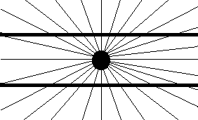

Do We Really See The Truth?
Are these lines parallel? Do they look it?
Are the soldiers the same height? Do they look it?
Are these drawings cheating or is it your brain responding to a well planned stimulus?

Slide 9

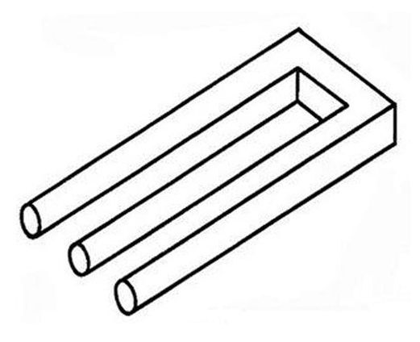
Based On Our Excellent Visual Acumen…. Let’s Build These And They Will Come!
After all, you have to be able to trust your senses!

Slide 10
If You Are Not Certain Of What You See…..
How can you possibly be confident in your decisions?
Is it possible that solutions are hiding in plain sight?
Are problems lurking that threaten productivity?
CONTACT US :
www.INFORModal.com
E-mail : Inquiry@INFORModal.com

